Slide 1
RUNGTA COLLEGE OF DENTAL SCIENCES & RESEARCH
WOUND , SINUS , FISTULA AND ULCER
DEPARTMENT OF GENERAL MEDICINE

Slide 2
Specific learning Objectives
At the end of this presentation the learner is expected to know ;
Core areas* | Domain ** | Category #
WOUND | COGNITIVE | DESIRED TO KNOW
WOUND REPAIR | COGNITIVE | DESIRED TO KNOW
BURN | PSYCHOMOTOR | MUST KNOW
SKIN GRAFT AND FLAP | COGNITIVE | MUST KNOW
SINUS | COGNITIVE | MUST KNOW
FISTULA | COGNITIVE | DESIRED TO KNOW
ULCER | COGNITIVE | MUST KNOW

Slide 3
Table of Content
WOUND
WOUND REPAIR
BURN
SKIN GRAFT AND FLAP
SINUS
FISTULA
ULCER

Slide 4
WOUND
Definition- Wound is a break in the continuity of skin or mucus membrane or body tissues due to some
external physical injury.
Types of wound
Wound may be classified in many ways.
1.Simple wound -When only the skin is involved.
Complex wound- When it involves
underlying structures like blood vessels or tendons or nerves.

Slide 5
Closed wound-
a) Abrasion
b) Contusion
c) Haematoma
B. Open wound-
a) Incised wound
b) Lacerated wound
c) penetrating wound
d) Crushed injury

Slide 6
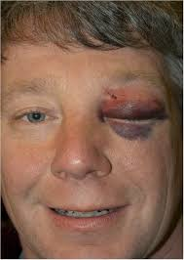
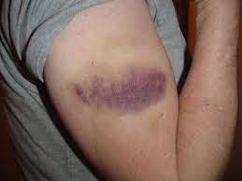
TYPES OF WOUND
Abrasion
Contusion
haematoma

Slide 7
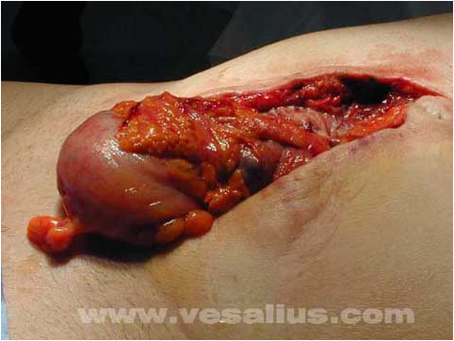
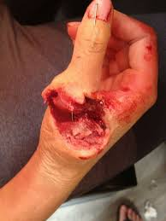
OPEN WOUNDS
Incised
Penetrating wound
Lacerated

Slide 8
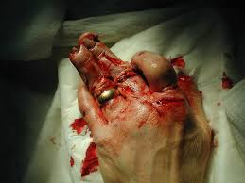

Slide 9
PRINCIPLES OF MANAGEMENT OF WOUND
HAEMOSTASIS
SURGICAL TOILET OF WOUND
a)Cleaning of wound
b)Debridement of wound.
c)Irrigation of wound with antiseptic solu.
Closer of wound-
a)Primary closer of wound.
b)Secondary suturing of wound
c)Skin graft
d)Skin flaps
4. Appropriate dressing of wound.
5 Antibiotics ,anti-tetanus and anti- gas gangrene measures.
6. Follow-up for dressing ,look for discharge and suture

Slide 10
WOUND DEBRIDEMENT-It is the removal of
dead or infected tissue present in the wound.it
helps in potentiating the healing process.
Surgical method
Mechanical
Chemical
Autolytic
Maggot’s therapy
Then depending upon the condition of wound ,may plan for its repair in following manner-

Slide 12
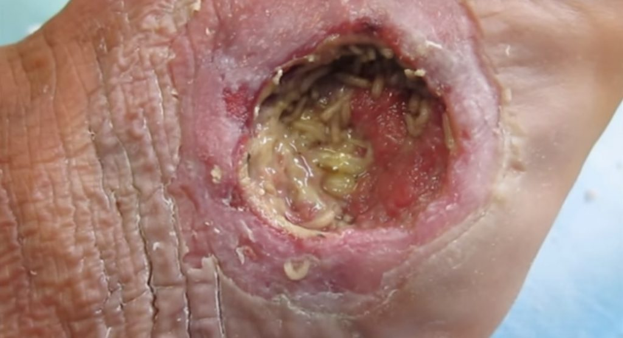

Slide 13
Closer of wound
1.Primary suturing and closer of wound.
Indication-1.Wound is fresh(with in 6hrs.).
2.No contamination of wound.
3.Wound is clean,edges are clear.
4.No oedema or tension.

Slide 14
2.-WOUND EXCISION AND PRIMARY
SUTURING
Indication-*wound edges are jagged
*Tissues are crushed and devitalised.
Procedure- *Wound is explored.
*Devitalised tissues and foreign
bodies if present,are removed. .
*The wound is irrigated with
antiseptic agent.
*And then suturing is done.
*It would be best to do
it before 6 hrs following injury.

Slide 15
3. Wound excision and delayed primary
suturing
When there is gross oedema of the part,increased tissue tension or contamination with bacteria.
Procedure-1.Excision of all dead tissue
2.Wound is thoroughly irrigated using
betadine or hydrogen paroxide etc.
3. Wound is kept open without suturing ,
dressing is done.Appropriate antibiotics given
4. After 4-5 days, wound is re-examined
and if found to be free from infection and
devitalised tissue,then suturing is done.

Slide 16
4. SECONDARY SUTURING –
Because of severe infection and in pus
discharging wound, it is not advisable to suture the wound initially.
In such cases,after controlling the infection with antibiotic and dressing etc,after 2 to 3 weeks ,skin margins are freed from the edge of wound and skin is approximated by applying sutures,this is called
secondary suturing.

Slide 17
5. WOUND WITH SKIN LOSS
This may happen after accident or after
surgery.
If skin loss defect is not treated,then it
may cause
1. Infection
2.danger to underlying nerve,tendon.
3.Deformity of the part and
4.May lead to septicaemia
TREATMENT-
As soon as possible, skin/flap grafting
Should be done after controlling the infection and having the healthy wound.

Slide 18
TYPES OF WOUND HEALING
1. Healing by Primary intension
It involves the uncomplicated healing of a
non-infected, well approximated wound
which leads into thin clean linear scar.
2. Healing by secondary intension.
It is healing in the infected wound which
leads into a wide poor ugly looking scar
formation.
3. Healing by tertiary intension.
It is a type of primary closer of wound after few
days, when the infection and edema etc. have been
controlled.

Slide 19
WOUND HEALING
Wound healing can be described in 4 stages.
1.Hemostasis phase-
*After injury, initially contraction of
blood vessels limiting blood loss.
* Platelets are activated. They seal the
leakages.
*Clotting factors activated and thus clot
formation takes place.

Slide 20
2. Inflammatory phase
* Injury activates the tissue collagen and results in release
histamine later kinins and prostaglandins.They play role as
chemotactics for WBC and fibroblast.
*Capillary permeability increases leading to escape of
RBC and WBC in the wound.
*In first 48 hrs,neutrophils plays the role as scavangers and
in next 3-5 days,monocytes appears and work as
specialised scavangers.
3. Proliferative phase
( epitheliasation and granular tissue formation)
By 5-6 days,fibroblast appear,proliferate and give rise to
protocollagen,which is converted to collagen in presence
of an enzyme protocollagen hydroxylase.

Slide 21
*Fibroplacia along with capillary budding gives rise to formation granulation tissue.
*Secretion of mucopolysaccharides,a gel like
substance by the fibroblast helps in binding of the collagen fiber and forms the ground substance.
* Epitheliasation mainly occurs from the edges
of the wound by a process of cell migration
and cell multiplication.
* Fibroblast also helps in wound contraction
thus reducing the defect size.

Slide 22
STAGE-4.
Maturation –(Scar formation & strengthening)
*fibroplacia and laying of collagen is increased.
*Vascularity becomes less.
*Epitheliation continues.
*In growth of lymphatics & nerve fibres starts.
*Remodeling of collagen takes place with
cicatrisation,resulting in scar formation.
*These process may continue for 1-2 years.

Slide 23
COMPLICATIONS OF WOUND HEALING
1.INFECTION
2.Ugly scar
3.Keloid formation
4.Incisional hernia
5.Pigmentation of skin
6.Marjolin’s ulcer

Slide 24
Factors affecting wound healing
GENERAL FACTORS-
1.Age of the patient
2.Nutritional status of patient
3.Diabetes Patient
4 Uraemia
5 Joundice
6.Malignancy
7.Patient on cytotoxic drugs
8.Corticosteroids drugs.

Slide 25
LOCAL FACTORS-
1.Presence of infection
2.Poor blood supply and lack of oxygen
3.Haematoma (leads to infection)
4.Tension at the wound while suturing
5.Faulty technique of wound closer.

Slide 26
COMPARTMNT SYNDROME

Slide 27
COMPARTMENT SYNDROME
DEFINITION-
-Compartment syndrome is a painful condition that occurs when pressure within the muscles builds to dangerous levels. This pressure can decrease blood flow, which prevents nourishment and oxygen from reaching nerve and muscle cells. Compartment syndrome can be either acute or chronic.
Pathogenesis- When there is injury to upper or lower lmb,
because of injury to blood vessels and other
tissue, there is collection of blood in one of the
Compartment of limb which raises the intra-
Compartmental pressure. If this raised pressure is
high and persist for a longer period, it may lead to
ischemia and then gangrene of the muscles in that
compartment.
This is called COMPARTMENT SYNDROME.
TREATMENT–Multiple longitudinal incision in the limb to release the pressure.

Slide 28
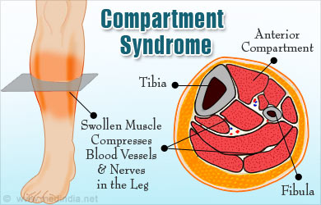
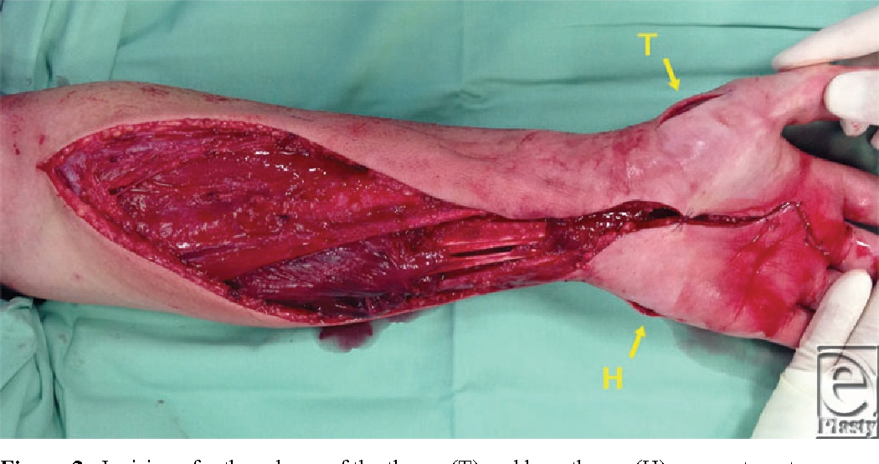

Slide 29
CRUSH SYNDROME

Slide 31
CRUSH SYNDROME
A crush injury is injury by an object that causes compression of the body. This form of injury is common following a natural disaster or after some form of trauma from a deliberate attack. Common concerns after an injury of this type are rhabdomyolysis and crush syndrome.
Crush syndrome (also traumatic rhabdomyolysis or Bywaters' syndrome) is a medical condition characterized by major shock and renal failure after a crushing injury to skeletal muscle. The syndrome may develop after one hour in a severe crush situation, but it usually takes four to six hours of compression for the processes that cause crush injury syndrome to occur.

Slide 32
The main presenting complications are-
1.Traumatic rhabdomyolysis-
AS it pertains to crush syndrome, results when muscle mass is compressed, causing direct injury to muscle fibers. As the tissue is compressed, it is deprived of blood flow and becomes ischemic, eventually leading to cellular death. The time to injury and cell death varies with the crushing force involved; however, skeletal muscle can often tolerate ischemia for up to 2 hr without permanent injury. In the 2- to 4-hr range, some reversible cell damage occurs, and by 6 hr irreversible tissue necrosis generally sets in.

Slide 33
2.Crush injury also causes Hypovolumia by hemorrhagic volume loss and the rapid shift of extracellular volume into the damaged tissues.
3. Acute renal failure (ARF) is caused by hypo perfusion of the kidneys, which normally receive 25% of cardiac output.
This hypo perfusion compounds with the
toxicity caused by cast formation and mechanical blockage of the nephrons by myoglobin .
.4.DIC.

Slide 35
MANAGEMENT of crush syndrome
Diagnosis-1 .Estimation of serum myoglobin
(normal-less than 75ng/ml)
2 . A simple but rapid test for
rhabdomyolysis can be done with a
standard urine dipstick. The heme-
- portion of myoglobin causes a positive
reading for blood on the test strip, and
heme-positive urine in the absence of any
red blood cells on microscopic examination
suggests myoglobinuria.
3. Creatine phosphokinase (CPK) is another
marker of muscle damage.

Slide 36
TREATMENT
1.The most important pre hospital treatment goal should be the removal of the crushing forces.
2. Intravenous fluid therapy with aim to volume expansion--
whether out-of-hospital or in-hospital, begins with the initiation of intravenous Initial fluid therapy should be directed at correcting tachycardia or hypotension with rapid volume expansion using isotonic sodium chloride solution or lactated Ringers solution and then slowing to a more controlled rate of 1 to 1.5 L/hr as a continuous infusion . The ultimate goal of therapy is aimed at achieving a urine output of 300 to 400 mL/hr. This aggressive volume expansion can prevent the rapid death, sometimes known as rescue death, which often accompanies removal from the crushing forces and reperfusion of ischemic tissue.
3.Treatment of other associated injury,antibiotics.Measures to prevent
tetanus and gas gangrene.
*************

Slide 37
SKIN GRAFT AND FLAP

Slide 39
Indication for skin and flap grafting
1.Skin loss-
a) post traumatic
b) Post surgical
2.Mucosa loss-
a) After excision of oral lesion
b) For resurfacing reconstructed vagina
3.In plastic and reconstructive surgery

Slide 40
Contraindication for skin grafting
1.Infection by beta hemolytic streptococcus.
2.Infected wound with copious discharge.
3.Avascular wound , exposed bare bone/tendon
exposed cartilage. Here in all ,flap grafting is preferred.

Slide 41
SKIN GRAFTING
Skin grafting is the most common method of achieving the wound cover.
TYPES-
1.Split skin graft(Thiersch graft,partial thickness)
*It consist of epidermis and some part of
dermis.
* It is harvested by using Humby’ knife.
* Preferred donor area is thigh.
* It’s drawback is contraction and colour
changes of skin graft.

Slide 42
2.Full thickness graft-
* It is consist of epidermis and full thickness of
dermis.
*Harvested using ordinary scalpel.
*Used for small uncontaminated wounds.
* Recipient area should have good vascularity.
* It does not contract,unlike SSG,retains colour so cosmatically
good.
3.Composit-It is a small graft containing skin and underlying cartilage or other tissues.(e.g.-Ear skin & cartilage to reconstruct nasal rim)

Slide 43
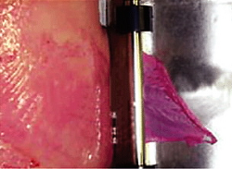
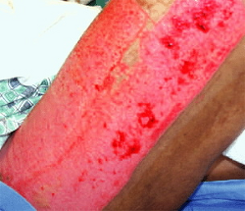

Slide 44
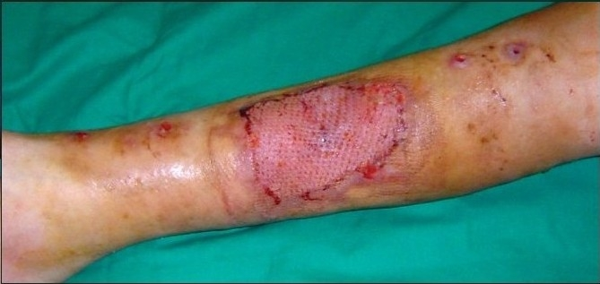

Slide 45
SKIN FLAPS

Slide 47
FLAP GRAFTING
Flap grafting is commonly used in plastic surgery
and in reconstructive surgery.
Flap is a block of tissue taken fron donor to
recipient area with its integrated blood supply where as in skin graft,blood supply is from the new channel developed at recipient site.
Common indication of flap surgery-
1.To cover wound where free skin graft cannot be used,e.g.-exposed bare bones/tendon.
2.Implant exposure-in orthopedic surgery.
3.In wounds of soft tissue loss.
4.For better contour of part.
5 Breast reconstruction following mastectomy.

Slide 48
CLASSIFICATION OF FLAPS
Based on method of transfer-
1.Pedicle flap-
a) local flap-Rotation,limberg
b)Regional e.g.PMMC,TRAM
c)Distant-eg.Groin flap for
hand defect.
2.Free flaps-
These are completely detached
from donor and immediately vascularity
is restored by anastomosis of blood
vessels of the recipient person.

Slide 49
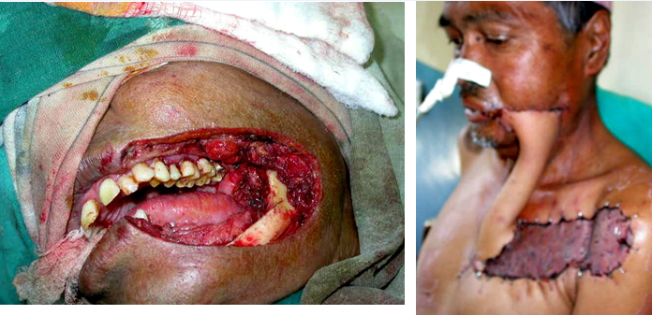
PEDICLE FLAP

Slide 50
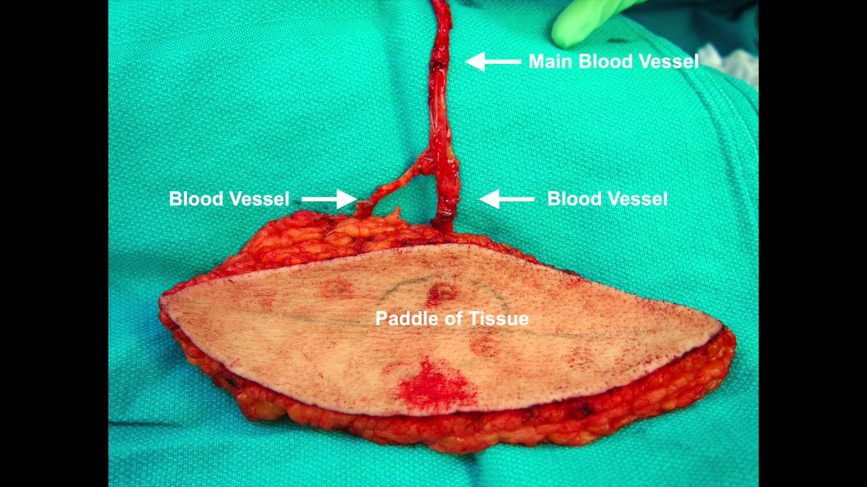
FRRE FLAP

Slide 51
Clasification : Based on composition of of tissue-
*skin flap
*Fasciocuteneous
*Muscle flap
*Myocuteneous
* Osteo cuteneous
Some commonly used flaps
1.Forehead flap-repair of nose
2.DP-Defect of nose and lower neck.
3.PMMC-Ideal pedicle graft for repair of head & neck defect.
By including 5th 6th rib,it can be used for mandibular reconstruction.
4.LDF-For breast,lower neck,chest wall

Slide 52
BURN
Definition-
Burn-It is a type of injury in which
coagulative necrosis take place, caused by
heat.The heat is transferred from source to
body.
Frost bite –It is also type of coagulative
necrosis caused by excessive cold,but it is
not a burn.
scald –It is a burn but caused by moist heat.

Slide 53
Types of burn-
1.Thermal-Flame burn,scalds
2.Electrical
3.Chemical
Pathophysiology in burn-
*Increased capillary permeability
*Increased capillary hydroststic pressure.
* Reduced clearence due to blocking of lymphatic vessels.
*Increased evaporative fluid loss.
*Depressed myocardial function

Slide 54
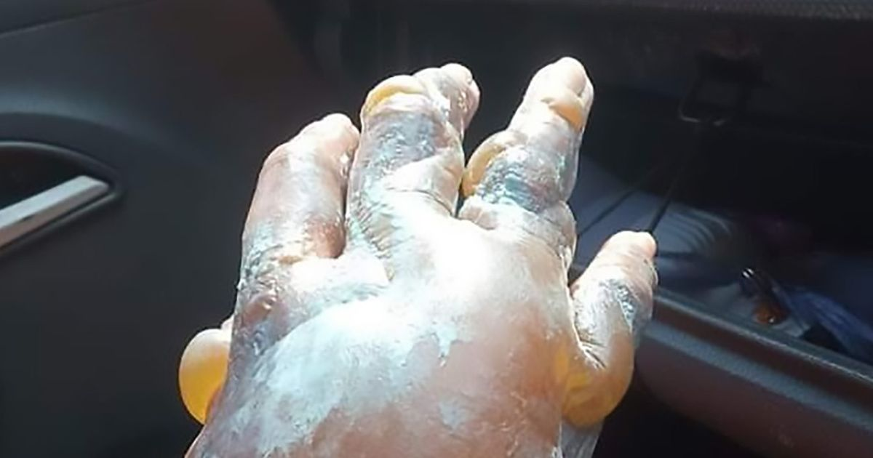

Slide 56
MANAGEMENT OF BURN PATIENTS
1.First aid-cold water bath etc.
2.Assessment of depth of burns.
3.Assessment as per surface area of body involve.(rule of nine)
4.TPR
5.Urinary catheter
6.Ryle’s tube feeding

Slide 57
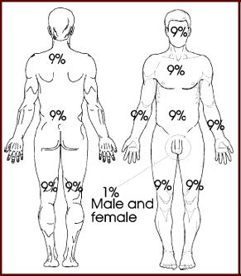

Slide 58
7.Replacement of fluid volume
* Muir and Barclay formula
( 1 ration = %of burn x body wt./2 )
3 ration in first 12 hours,
2 ration in next 12 hours &
1 ration in next 12 hours.
*Parkland’s formula:
First 24hrs:2ml/% of burn/kg(Deficit) + maintenance
(2500ml),
Second 24hrs: 50% of deficit+ maintenance 2500ml.
.Rate of fluid administration-50% in
first 8hrs after injury
and rest 50% in next 16 hrs.

Slide 59
8.Broad spectrum antibiotic
9.Treatment of burn area-
a. Clean wound with antiseptic solu.
b. open method
c. Closed method
d. Tangential excision followed by skin
grafting.
******

Slide 60
KELOID & HYPERTROPHIC SCAR

Slide 61
Keloid-
it is an abnormal over growth of dense fibrous tissue that usually develop after healing of skin injury. (eg : on the site of a surgical incision or trauma). It does not regress and grows beyond the original margins of the scar.
Keloids should not be
confused with HYPERTROPHIC SCAR.

Slide 62
KELOID
Keloid is due to defect in maturation and
stablisation of collegen fibrils.
Common in blacks, and in female
Genetically predisposed,often familial
Keloid continue to grow even after 6 months to years.
It extend into adjacent normal skin.
Brownish black in colour,painful & tender.
Common site is STERNUM,chest wall,upper
arm and lower neck infront.
D/D- hypertrophic scar.

Slide 63
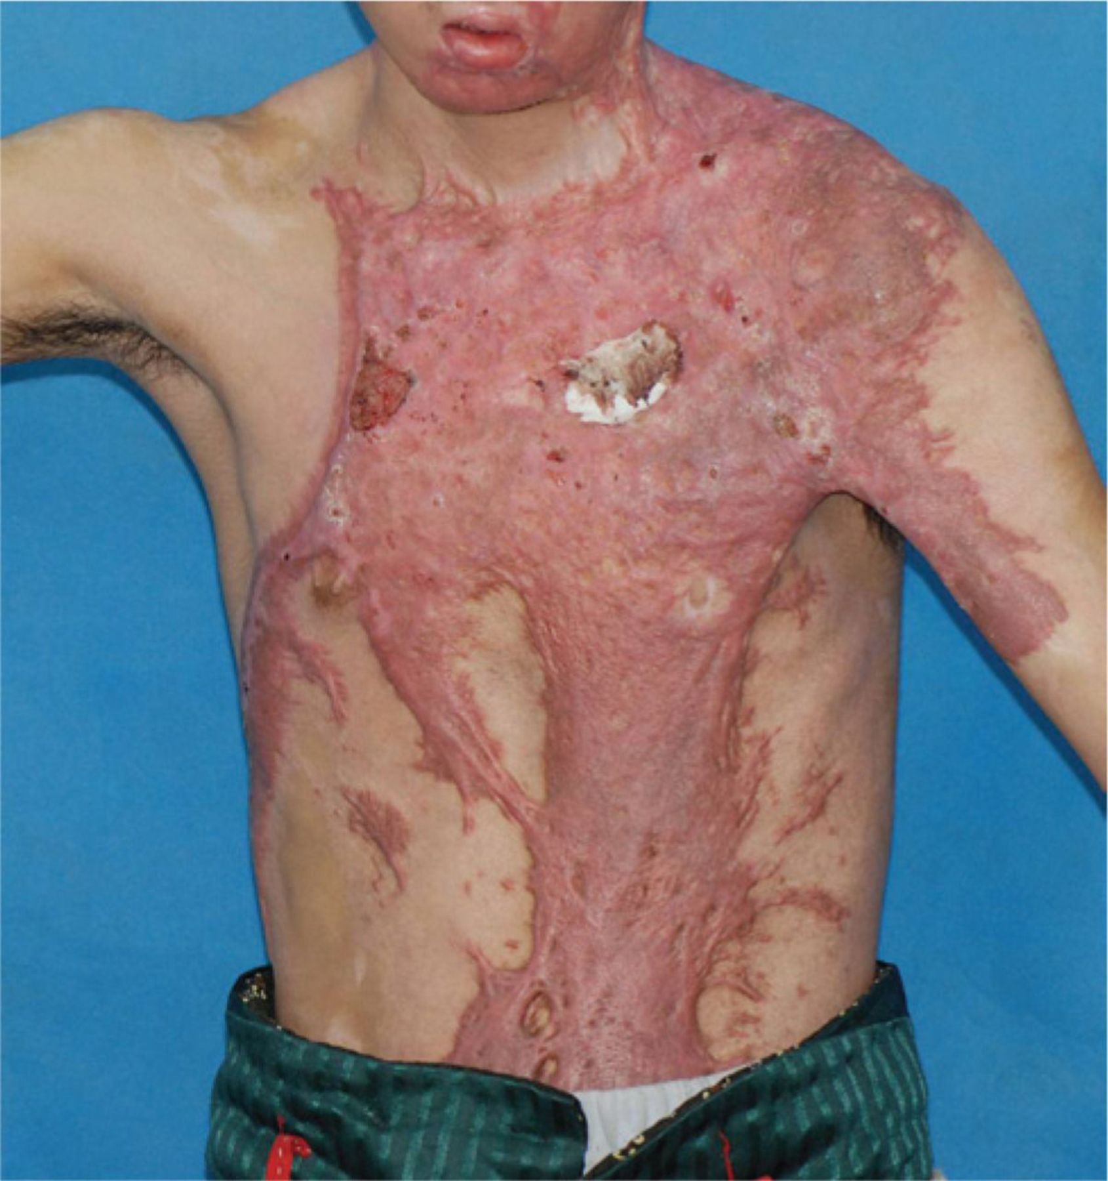
keloids

Slide 64
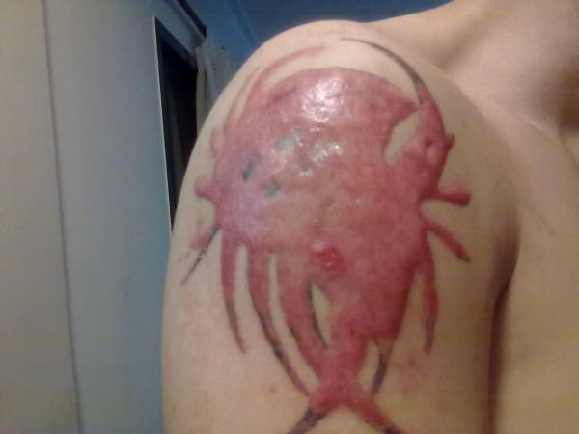

Slide 65
Treatment of keloid
It is difficult to treat.
Injection of steroid(kanacort) has been found to be useful.
Intrakeloidal excision and skin grafting is to be tried last.
During surgery,care to be taken not to extend the incision on to the normal skin.
Locally antipruritic gel may be applied.
****

Slide 66
HYPERTROPHIC SCAR
It is due to the hypertrophy of mature
fibroblasts.Blood vessels are minimal in this
condition. It never grows beyond the original
scar margin.It is non tender and non vascular.
Precipitating factors-
1.Scar crossing normal skin creases.
2.Over sternum,over joints
3.Young persons

Slide 67
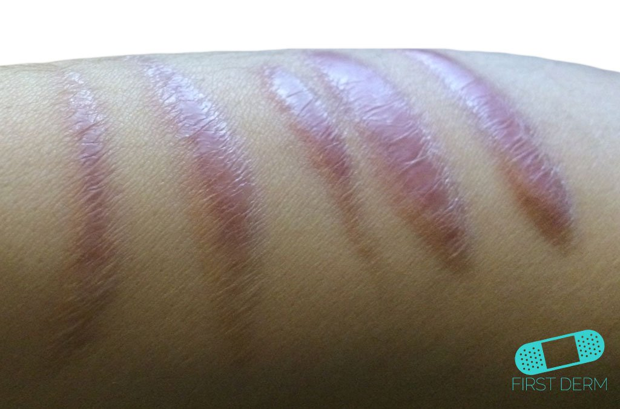
HYPERTROPHIC SCAR

Slide 68
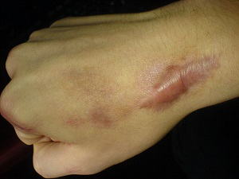
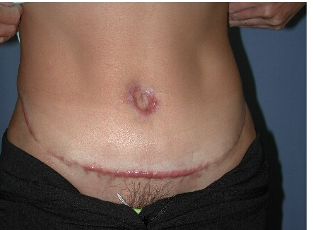

Slide 69
HYPERTROPHIC SCAR
A hypertrophic scar is a cuteneous condition charaterized by
deposit of excessive amount of collagen which gives rise to a
raised scar.Commonly seen at the site of pimples,cuts,burns
and body piercing point.
1.It can occur any where in the body.
2.Not predisposed to genetically or familial.
3.Growth usually limits upto 6th month.
4.Limited to scar tissue,no invasion of normal skin.
5.It is pale brown in colour,no pain,non tender.
6.Often self limiting,respond well to steroid treatment.
7.Recurrence is uncommon.
Complications-
* Repeated breakdown of scar may cause infection and pain.
* After repeated breakdown,it may turn into MARJOLIN’S ulcer.
*****************

Slide 70
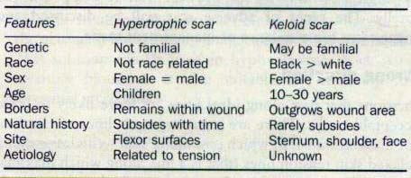

Slide 71
Treatment of hypertrophic scar
It is often not required
Stocking,armlets,gloves and elastic bandage may help.
Excision can be done.Recurrence is not common.
********

Slide 72
ULCER

Slide 73
ULCER
Definition-
-An ulcer is a discontinuity of the skin or
mucous membrane which occur due to some
underlying pathology and microscopic death
of tissue there.
*An ulcer can occur anywhere in the body-
skin,oral cavity,penis or in the duodenum,
intestine etc.

Slide 74
CLASSIFICATION OF ULCER
Can be classify in two ways-
1.Pathological
2.Clinical
Pathological classification
1.Non-specific-
Traumatic (Physical trauma,burns,radiation or chemical)
Venous(Varicose and post thrombotic ulcers)
Arterial( Atherosclerosis,Vasospastics,Martorell’s ulcer)
Neurogenic ( neuropathic,Trophic ulcer-leprosy,diabetes etc
Tropical (malnutrition & infection due to Vincent’s org.
Diabetic (foot,leg)
blood dyscrasis(sickel cell,leukaemia)
2.Specific ulcer-
Syphilitic, tuberculosis etc.
3.Malignant ulcers

Slide 75
Clinical classification-
1.Spreading 2.Callous 3.Healing ulcer
Spreading-
No granulation tissue
Purulent discharge
Excessive slough
Surrounding area inflammed & oedematous
Foul smell present

Slide 76
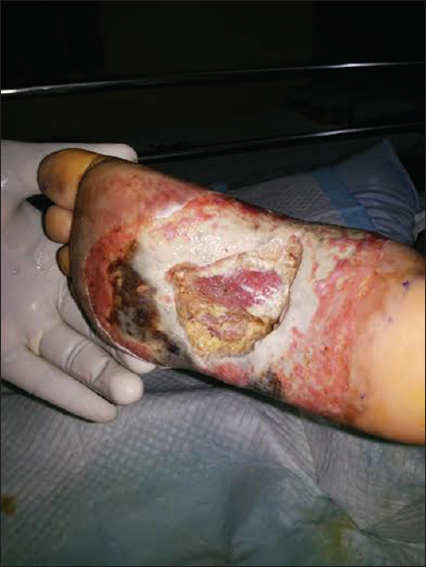

Slide 77
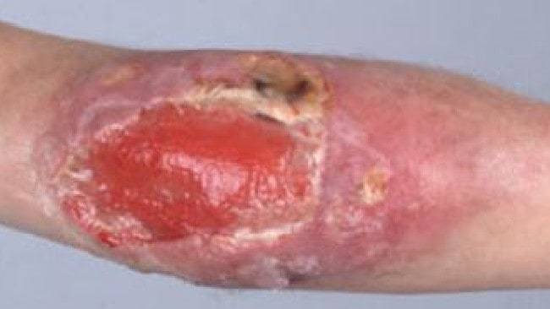

Slide 78
Callous ULCER
Pale granulation tissue
Serous discharge
Slough present
Induration at base,edge and surrounding area
Smell may be present

Slide 79
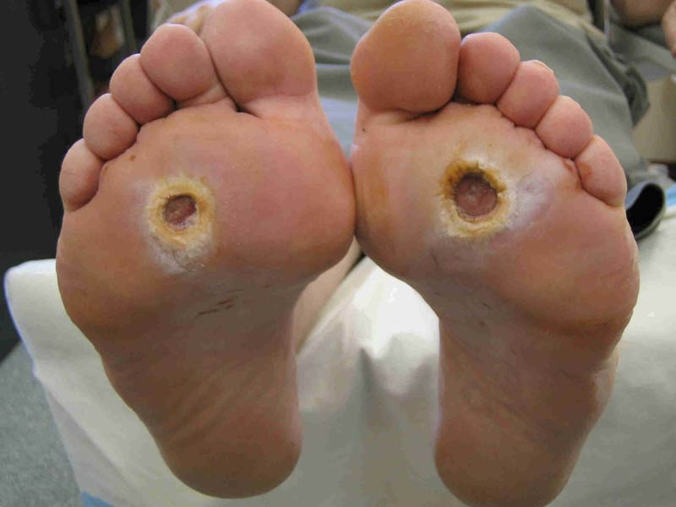

Slide 80
Healing ULCER
Red granulation tissue
Minimal serous discharge
Slough absent
Minimal signs oh inflammation
Smell absent

Slide 81
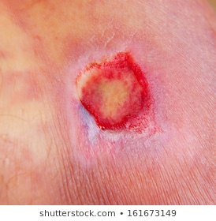

Slide 82
PARTS OF THE ULCER
Margin and Edge of an ulcer
These two term should not be confused.
Margin is the junction between the normal
epithelium and the ulcer.So it boundary
of a ulcer.
Edge is the area between the margin and
the floor of the ulcer.
2. Floor and Base of ulcer-
Floor is the exposed surface within the ulcer.
Base is on which the ulcer rests.It is better felt, then seen.

Slide 83
TYPES OF EDGES OF AN ULCER

Slide 84
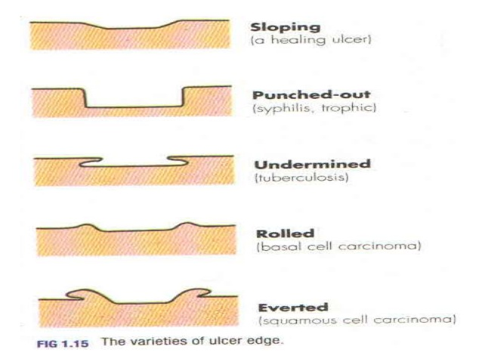

Slide 86
leg ulcers

Slide 87
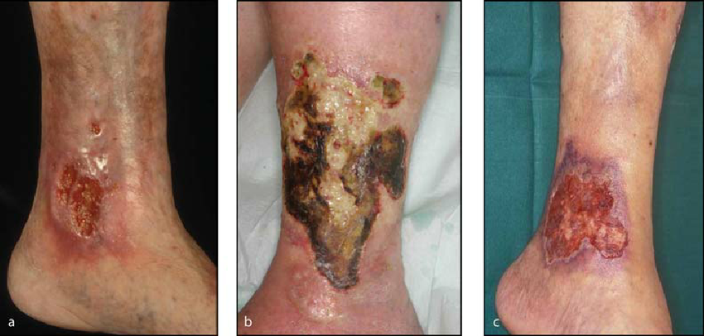

Slide 88
Differential diagnosis of leg ulcer
Common causes-
1.Traumatic ulcer
2.Varicose ulcer
3.Arterial ulcer
4.Diabetic ulcer
Uncommon causes-
5.Neurogenic ulcer
6.Tropical ulcer
7.Post-thrmbotic ulcer
8.Malignant skin ulcer
Rare causes-
9.Mortorell’s ulcer
10.Bazin’s disease

Slide 91
Home work/Expected short-notes
1.Read and Write management of Diabetic ulcer.
2.Management of a venous ulcer.
3.Management of a bedsore.
4.Difference between venous and arterial ulcer.

Slide 92
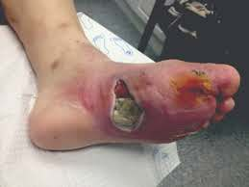

Slide 93
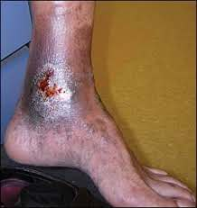

Slide 94
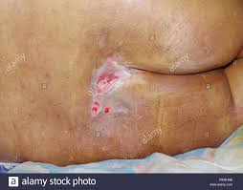

Slide 95
THE END

